Slide 1

DATABASE SYSTEMS (EIE36E): Database Normalization
Doc. Ing. Václav Vostrovský
Ing. Petr Hanzlík

Slide 2

Outline >
Database normalization
Principle and advantages
Normal forms

Slide 3
What is DB normalization
Process of applying a set of rules to your database design, mostly to achieve minimum redundancy in the data
Stepwise, reversible process of replacing a given set of relation with relation of a simpler structure.

Slide 4
DB normalization
Can start with universal relation U
Can be executed after implementation-level diagram is created (ER diagram, Class diagram..)

Slide 5
First normal form (1NF)
All attributes must be atomic
No repeating groups of columns
Identify each row with a unique column or set of columns (the primary key)

Slide 6
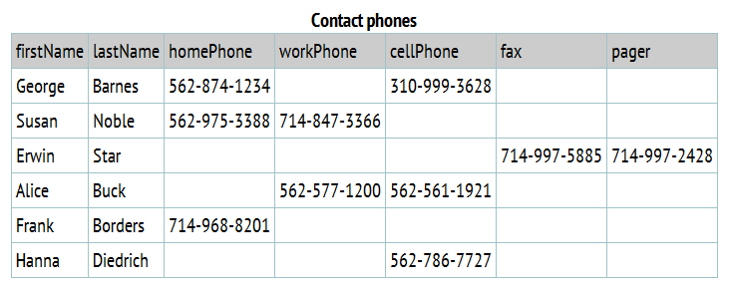
First normal form (1NF)
Remove repeating attributes:
* By Tom Jewett

Slide 7
First normal form (1NF)
Remove repeating attributes:
* By Tom Jewett

Slide 8
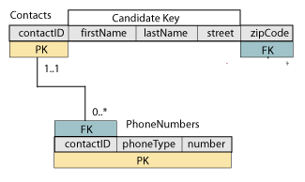
First normal form (1NF)
Remove repeating attributes:
* By Tom Jewett

Slide 9
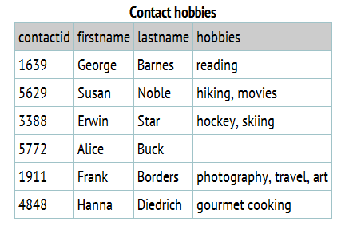
First normal form (1NF)
Eliminate multi-valued attributes:
* By Tom Jewett
Notes:
Difficult (but possible) to search the table for any particular hobby that a person might have
Impossible to create a query that will individually list the hobbies that are shown in the table

Slide 10
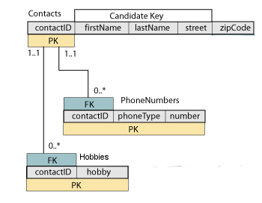
First normal form (1NF)
Eliminate multi-valued attributes:
* By Tom Jewett

Slide 11
Choosing a primary key
Primary key UNIQUELY identifies a row
Does not have to be a single value!
Composite (compound) key – consists of multiple attributes

Slide 12
Second normal form (2NF)
First normal form
No partial functional dependencies
non-key elements must depend on every part of the primary key

Slide 13
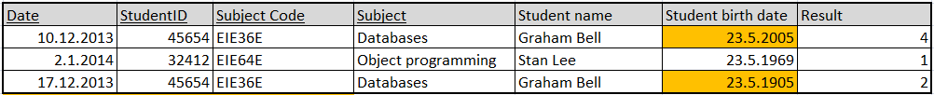
Second normal form (2NF)

Slide 14
Second normal form (2NF)
Eliminate functional dependencies

Slide 15
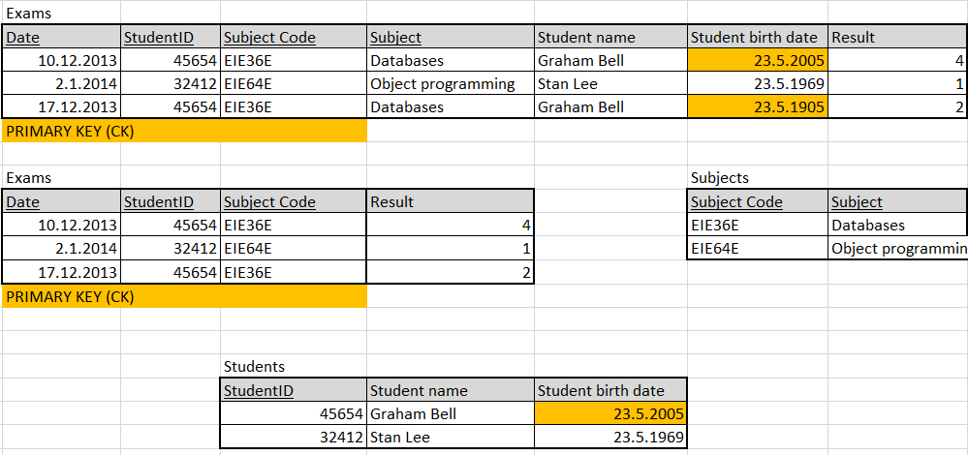
Second normal form (2NF)

Slide 16
Third normal form (3NF)
Second normal form
No transitive functional dependencies
There are no non-key attributes that depend on another non-key attribute
* IF A->B and B->C then A->C

Slide 17
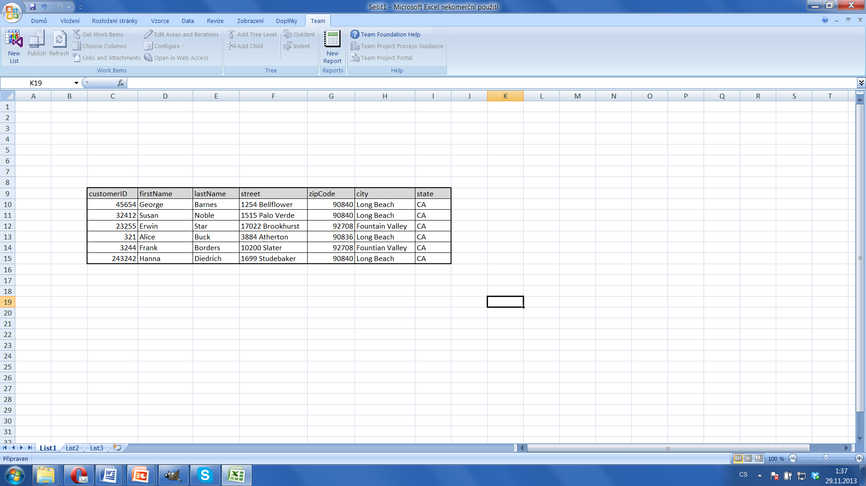
Third normal form (3NF)

Slide 18
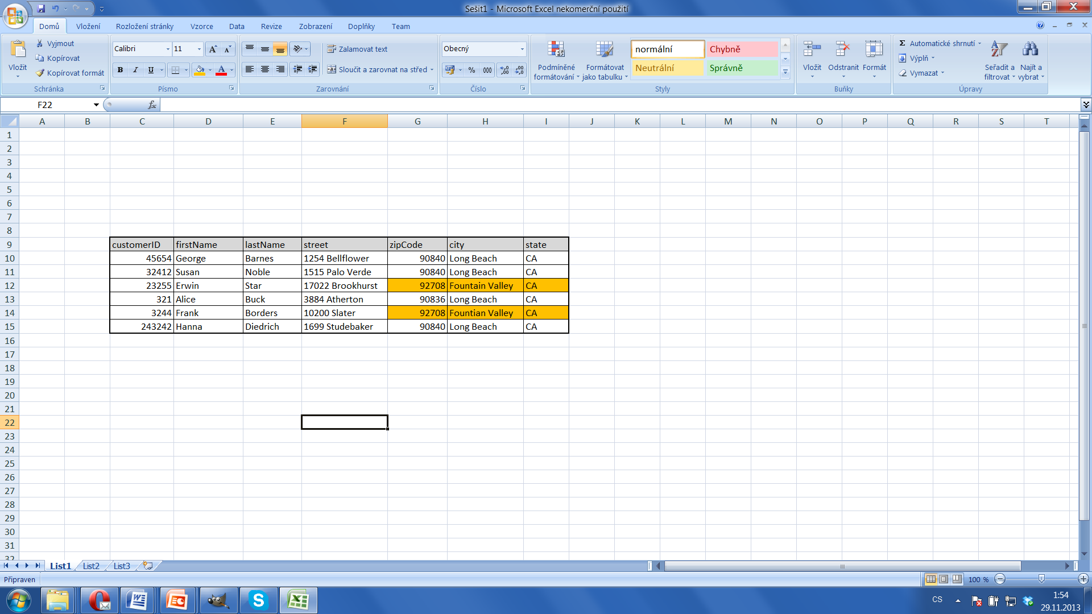
Third normal form (3NF)

Slide 19
Third normal form (3NF)
Transitive dependencies

Slide 20
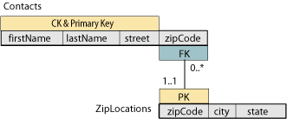
Third normal form (3NF)
Eliminate the subkey

Slide 21
Composite primary key
Primary key that includes multiple columns
ORACLE composite PK syntax:
CREATE TABLE table_name (
column1 DATATYPE,
column2 DATATYPE,
…
PRIMARY KEY (column1, column2, …));
Notes:
The whole primary key must be referenced in a foreign key.

